Slide 1
Estimation Proofs

Slide 2
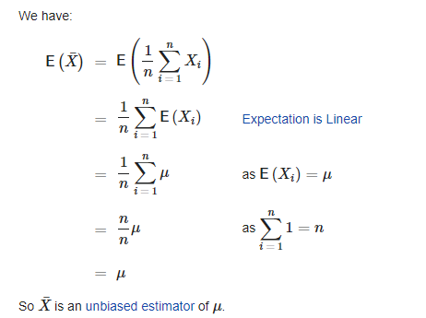
Prove that sample mean is unbiased estimator of population mean

Slide 3

Prove that sample variance is unbiased estimator of population variance
Imagine that we are drawing a sample of size (n) from a population which has parameters μ and σ.
The variance of a particular sample (of size n) is given by the following equation.

Slide 4

Proof (Cont.)
Obviously, the value of individual s² is likely to be different from sample to sample.
While the sample variance itself is a random variable, the question is “what is the theoretical average or expectation of s² ?”.
That is, if we are to draw a large number of times (say 1 million) -each time a sample of size n, then what can be expected as the average value of s²?
Taking the expectation both sides,

Slide 5
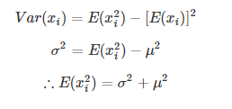
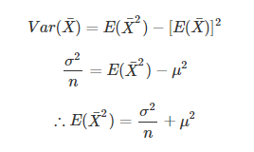
Proof (Cont.)
We need some basic results:

Slide 6
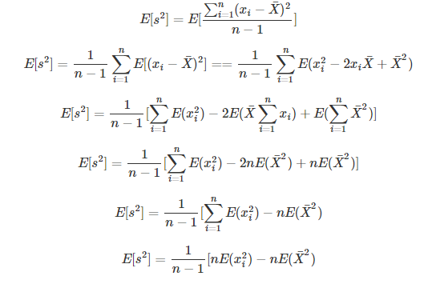
Proof (Cont.)
Using the results

Slide 7
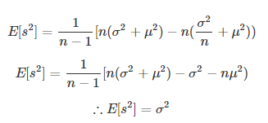
Proof (Cont.)
Using earlier results
Hence Proved

